Slide 1
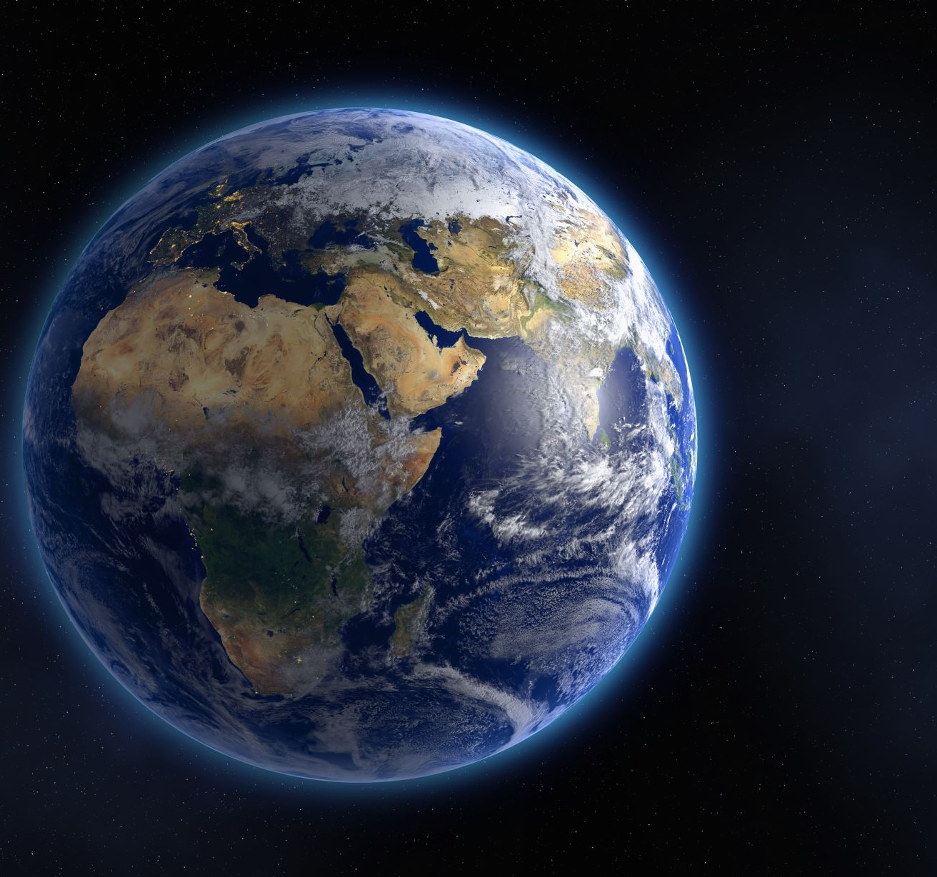
The Earth day
Information, and about climate change.

Slide 2
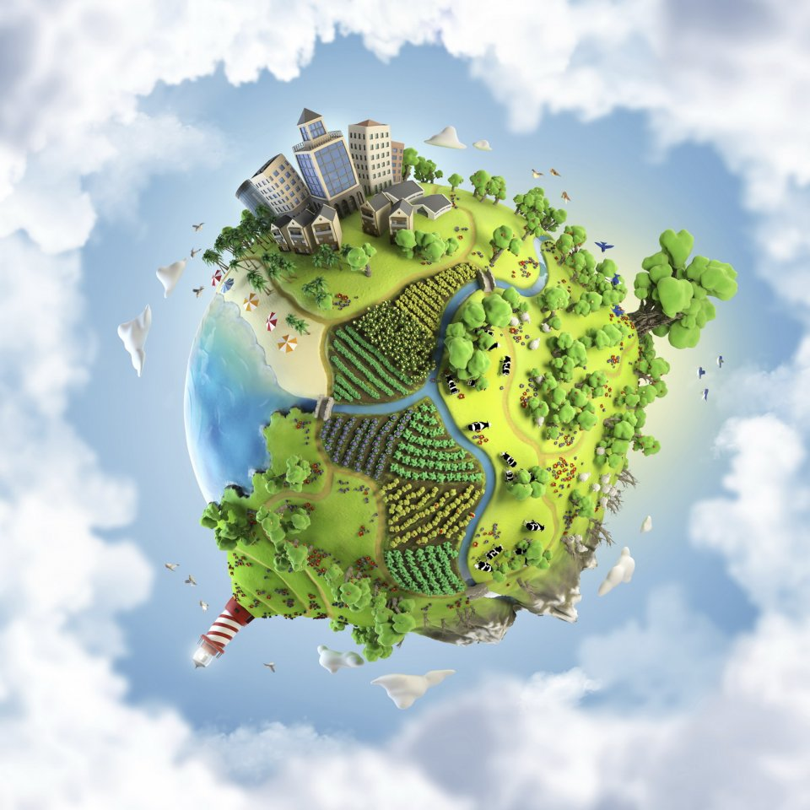
The earth day
The earth day is every year on 22nd of April. It's celebrated since 1970 and it is celebrated all around the globe.
On the earth day everybody remembers the planet that we are living on and try to make our planet better so we can live on it longer .
The Earth day celebrates 50 years since it started and made a lot of partners to protect our planet.
But sadly, the earth is being destroyed by many things that us humans do and one of those things is climate change

Slide 3
Climate change

Slide 4
The start of the climate change
Climate change was discovered in the early 19th century when people noticed that ice caps were melting, and greenhouse effect was seen.
Later in the century scientist argued if it has some connection and if it could change the climate.
In 1960s the evidence of climate change became more and more convincing because of that some scientists said that it was the fault of us and our activities that are making these gases.

Slide 5
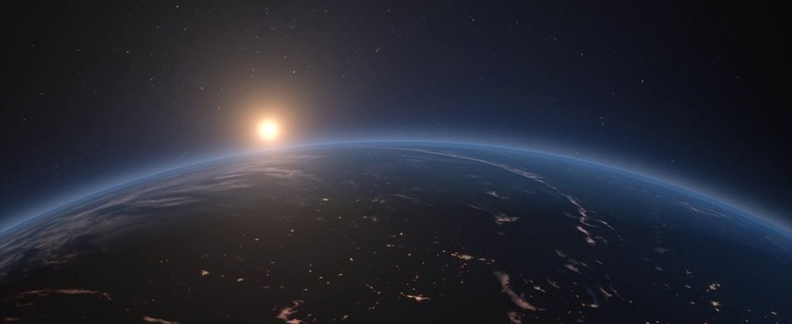
After discovery of climate change
In 1990s scientist could not deny the climate change and that it warmed up our planet
Scientist also discovered that it was our fault because of emissions.
The public also started noticing some things and started to fear the earth getting much warmer.
Also, in 1990s research of climate change was expanded and more scientists joined to know more about protecting our planet.

Slide 6
Climate change now
People see climate change as a big problem and trying to do everything to help it stop it but there are also people that are still denying it.
The climate change is bigger problem than it was been last years because more people are driving cars and using more things that are producing greenhouse gases.
Luckily, some greenhouse gases have been banned in being in products but there are still many more.

Slide 7
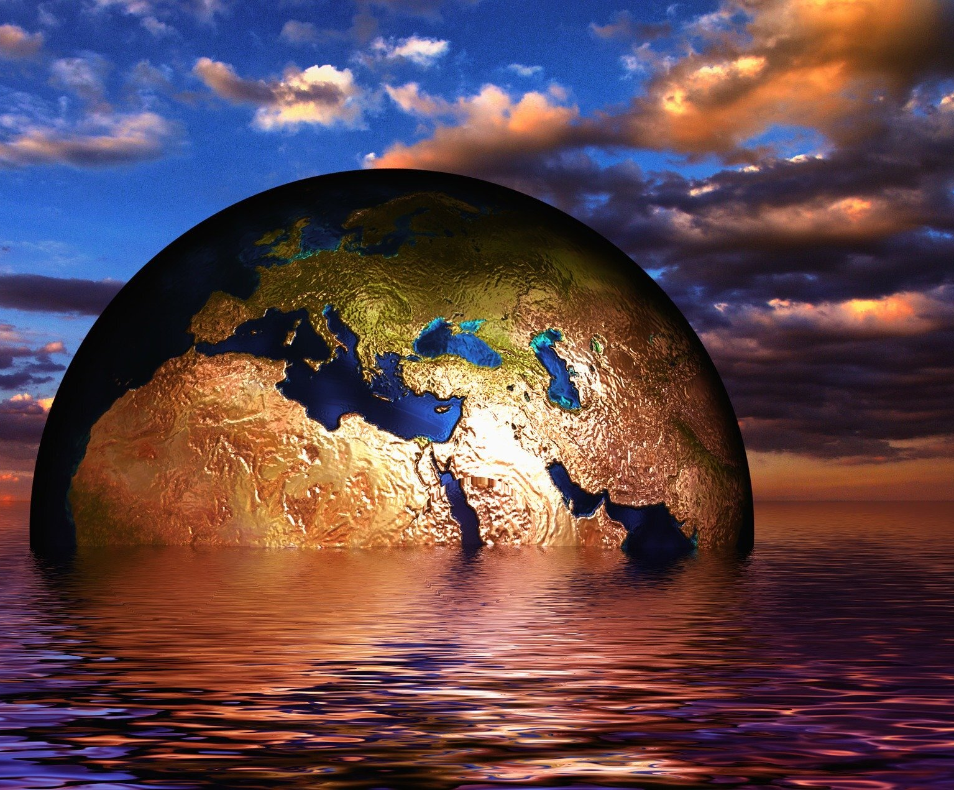
What can you do to help the planet?
Don’t ride by cars so often use public transport, ride a bike or go for a walk.
Don’t use so much water. It still helps the climate change
Recycling also helps a little so do it you don’t have a reason not to.
Don’t use much energy. Use it wisely and turn off the lights when going out of the room and not coming back.
Help people understand the problem and try to show them what to do and what is bad.

Slide 8
Thanks for attention We have only one planet take care of it

